Slide 1

Basic Saving and Investing

Slide 2

Overview: Topics
The Basics
Establishing Savings
Saving vs. Investing
Investing
The TSP Funds

Slide 3
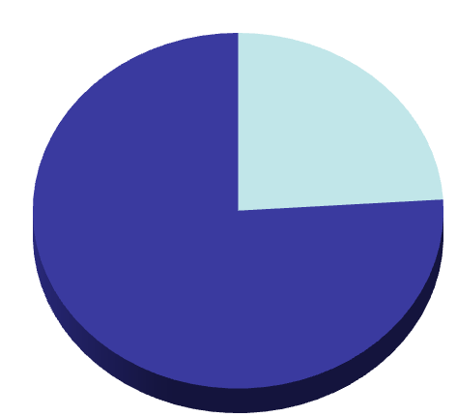
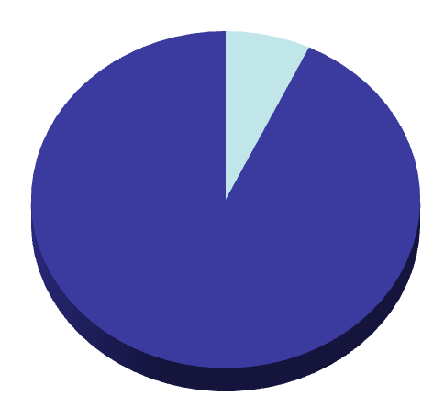
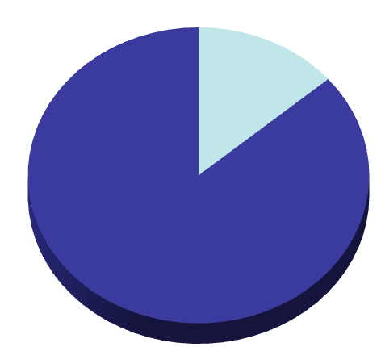
Start Early
What will it take to have ½ million dollars at retirement…starting at age 25? 35? 45?
$37,920
$79,560
$157,920
$79 per month
$37,920 Out of Pocket
$221 per month
$79,560 Out of Pocket
$658 per month
$157,920 Out of Pocket
25
35
45

Slide 4
The Financial Planning Pyramid
Options, Commodities, etc.
Real
Estate
Hard
Assets
INVESTMENT LEVELS
Stocks
Bonds
Mutual
Funds
SAVINGS
LEVEL
Reserve
Emergency
Goal-
Getter
MANAGEMENT
LEVEL
Adequate
Income
Controlled Spending
Adequate
Insurance

Slide 5
Savings Factors to Consider
Safety
Liquidity
Yield
Options, Commodities, etc.
Real
Estate
Hard
Assets
INVESTMENT LEVELS
Stocks
Bonds
Mutual
Funds
SAVINGS
LEVEL
Reserve
Emergency
Goal-
Getter
MANAGEMENT
LEVEL
Adequate
Income
Controlled Spending
Adequate
Insurance

Slide 6

Savings Vehicles
Regular Savings Account
Money Market Accounts
U.S. Savings Bonds (EE and I)
Certificates of Deposit

Slide 7

Regular Savings Accounts
Safety: Guaranteed up to $250,000
Liquidity: No restrictions on withdrawals
Yield: Generally the lowest interest rate .05-.35%
Bank or Credit Union

Slide 8

Money Market Accounts
Safety: Guaranteed up to $250,000, if insured
Liquidity: Generally no restriction on withdrawals
Yield: Low but higher than savings account - Average is .80 %
Bank, Credit Union or brokerage
May have a large minimum deposit, required minimum balance, and fees for withdrawals

Slide 9

Certificates of Deposit
Safety: Guaranteed up to $250,000, if insured
Liquidity: Invested for a fixed period, if liquidated before that - some interest may be forfeited
Yield: Average for 1-year is 2.5-3.5%
Bank, Credit Union or brokerage
Usually a minimum of $500

Slide 10
U.S. Savings Bonds: EE
Safety: Guaranteed
Liquidity: Can be redeemed after 12 months, subject to a 3 month interest penalty if held for less than 5 years
Yield: Fixed rate of return determined twice a year .10%
savingsbonds.gov
Minimum investment of $25
No commissions or fees

Slide 11
U.S. Savings Bonds: I
Safety: Guaranteed
Liquidity: Can be redeemed after 12 months, subject to a 3 month interest penalty if held for less than 5 years
Yield: Has two parts--a fixed rate of return and a variable, semi-annual inflation rate 1.9%
savingsbonds.gov
Minimum investment is $25 (electronic form) or $50 (paper form)
No commissions or fees

Slide 12

Savings vs. Investing
Different Time Frames
Different Risks
Inflation
Taxes
The Effect of Compound Interest and Time

Slide 13
The Vehicles of Investing
Options, Commodities, etc.
Real
Estate
Hard
Assets
INVESTMENT LEVELS
Stocks
Bonds
Mutual
Funds
SAVINGS
LEVEL
Reserve
Emergency
Goal-
Getter
MANAGEMENT
LEVEL
Adequate
Income
Controlled Spending
Adequate
Insurance

Slide 14

Equity: Stocks
Represent ownership
Returns from dividends and capital gains
Average Rate of Return is 8 - 10%
Can be purchased through a brokerage, an employer investment plan, or directly from issuing company
Higher risk than bonds
Need from 10 – 30 to diversify
Best choice for long-term growth

Slide 15

Fixed Income: Bonds
Represent money owed to investor
Issued by companies and governments
Should research the bond rating
3.7 – 5.5% Rate of Return
Moderate Liquidity
Provide Fixed-Income Payments
Reliable Income
Typically Purchased from a Brokerage

Slide 16

Mutual Funds
Mutual Funds
Pool of Investors
The Fund’s Professional Management
Diversified Portfolio
Interest & Dividends
Capital Gains
Net Asset Value

Slide 17

Advantages and Disadvantages of Mutual Funds
Advantages
Disadvantages
Professional Management
Diversification
Liquidity
Affordability
Cost Despite Negative Returns
Lack of Control
Price Uncertainty
Not Insured
Complex Records

Slide 18
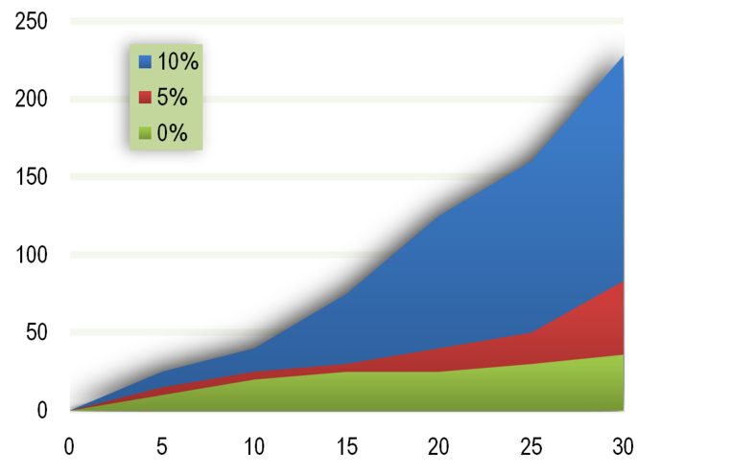
Compounding
$228,033
$228,033
Thousand $
$83,673
$83,673
$36,000
$36,000
Notes:
100 saved monthly

Slide 19

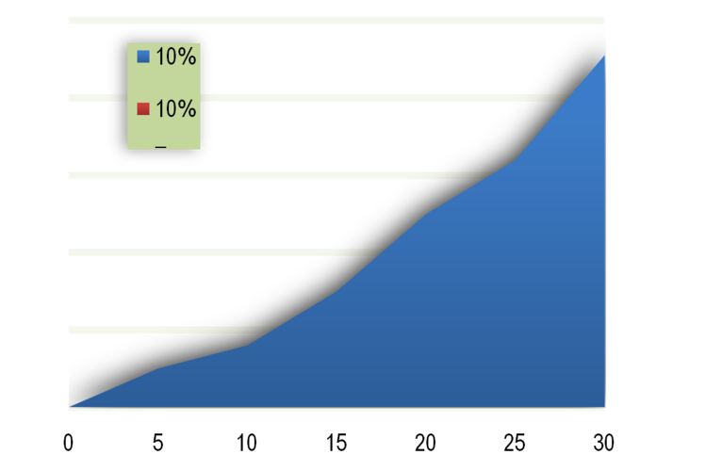
Should I Spend The Nest Egg?
$94,144 LOST!
$228,033
Thousand $
$133,889
Spend $7,800 nest egg on a car

Slide 20
What should I do with extra money?
Options, Commodities, etc.
Real
Estate
Hard
Assets
INVESTMENT LEVELS
Stocks
Bonds
Mutual
Funds
SAVINGS
LEVEL
Reserve
Emergency
Goal-
Getter
MANAGEMENT
LEVEL
Adequate
Income
Controlled Spending
Adequate
Insurance

Slide 21
Marine Contributes
Total Contribution
Government Contributes
0%
1%
1%
1%
3%
2%
Matching in BRS
2%
5%
3%
3%
7%
4%
4%
8.5%
4.5%
5%
10%
5%
Notes:
(2 minutes)
SAY: A major difference between the “High-3” retirement system and the new BRS is that the new blended system requires a Traditional TSP account for Service members where the Government will contribute to the account along with the member.
If you choose to participate in the BRS, you can set up a Traditional TSP account now if you do not already have one. Upon opting into the BRS you will choose the percentage contribution you want to make from your basic pay each month into your TSP. You can do this at MyPay, and the process is described in your handouts.
If you already have a TSP account and have already set up allocations and contributions, those allocations and contributions will continue until you change them.
SAY: In addition to the 1% automatic contribution, the Marine Corps will match your personal contributions up to 4% of your base pay as described in the graphic.
All agency contributions will go to a Traditional TSP account.
You will begin seeing these contributions the next pay period after you opt-in.
DO: Select next or click to advance the slide.

Slide 22

Opt In
Automatic
Contracted prior to 1 January 2018 (DIEMS/ DEAF)
Matching and automatic contributions begin pay period following election
No automatic TSP enrollment
No automatic TSP re-enrollment
Contracted on/ after 1 January 2018 (DIEMS/ DEAF)
Automatic contributions (1%) begin after 60 days of service
Matching contributions begin after two years of service
Automatic TSP enrollment at 3%
Automatic TSP re-enrollment each January

Slide 23
Taxes on Tax-Advantaged Accounts
Tax-deferred:
Taxes are deferred until you withdraw money
Employer or individually sponsored
Traditional: TSP, 401(k), IRA;
SIMPLE IRA, SEP-IRA
Tax-advantaged:
Roth TSP, Roth IRA
Non-deductible Traditional IRA

Slide 24
Saving in the Thrift Savings Plan
Getting the most bang for your buck

Slide 25

TSP Enrollment and Account Access
Enrollment
Account Access
TSP website
Thriftline
myPay website
Password and PIN

Slide 26

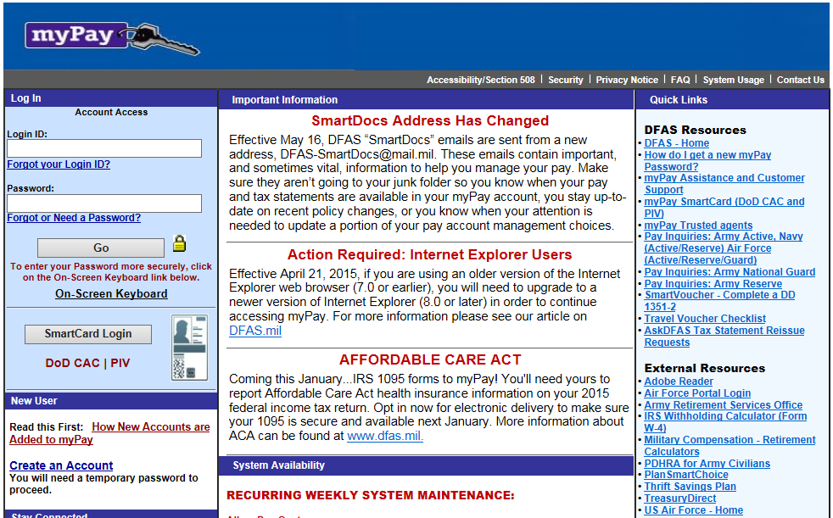
MYPAY
Notes:
(.5 minute)
SAY: Have you been on MyPay? MyPay is where you can access your LES, TSP functions, and other benefit information. You will find instructions on obtaining and accessing your MyPay account on the MyPay homepage at www.mypay.dfas.mil.
It is your responsibility to ensure your LES is accurate. Review your LES each month, and take any issues to your chain of command.
DO: Click or select to navigate to the next screen.

Slide 27
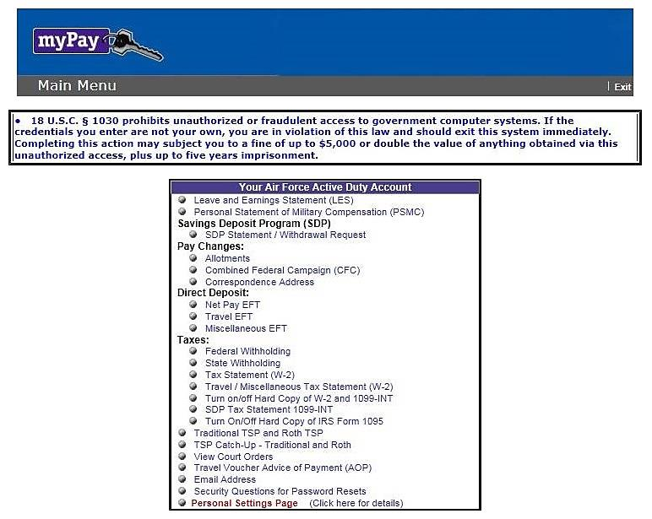

myPay Main Menu
Your Army Active Duty Pay Account
Leave and Earnings Statement (LES) Personal Statement of Military Compensation (PSMC) Blended Retirement System (BRS) Opt-in Opt into the Blended Retirement System Savings Deposit Program (SDP) SDP Statement / Withdrawal Request Pay Changes: Allotments Turn on/off Hard Copy of LES Direct Deposit: Net Pay EFT Travel EFT Miscellaneous EFT Taxes: Federal Withholding State Withholding Tax Statement (W-2) IRS Form 1095 Student Loan Repayment Program (SLRP) W-2 Travel /Miscellaneous Tax Statement (W-2) Turn on/off Hard Copy of IRS Form 1095 Traditional TSP and Roth TSP TSP Catch-Up – Traditional and Roth View Court Orders Travel Voucher Advice of Payment (AOP) Email Address Security Questions for Password Resets Personal Settings Page (Click here for details)

Slide 28
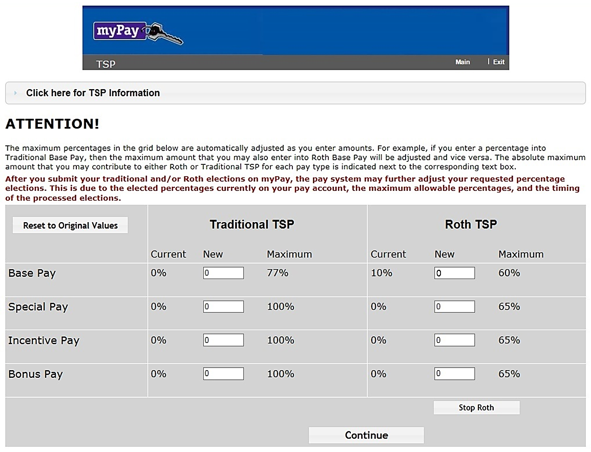
Contribution Elections in myPay

Slide 29
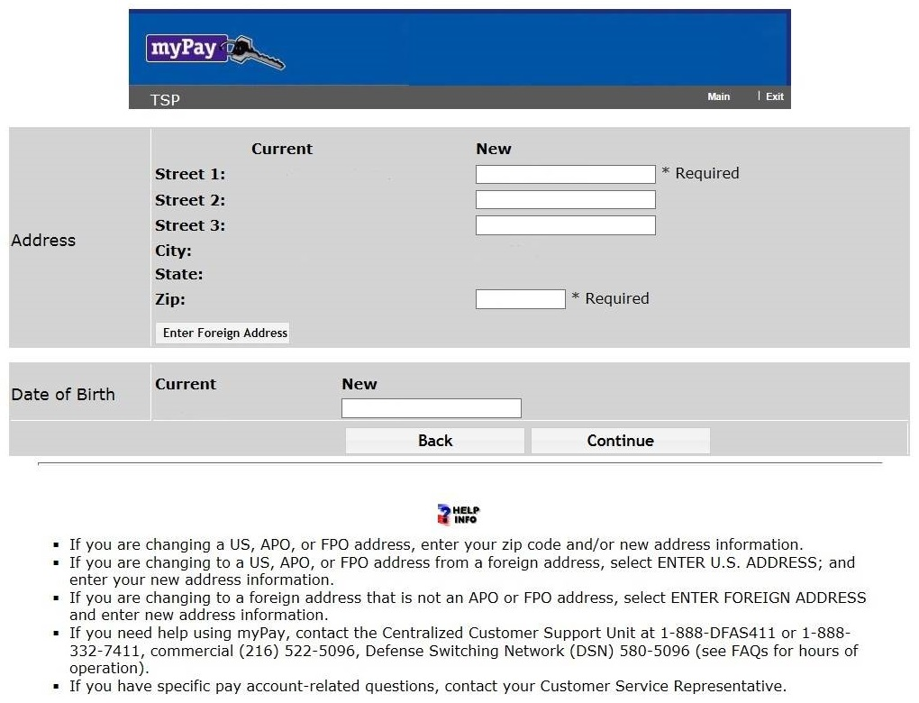
Update Address and Date of Birth in myPay
If you are changing a US, APO or FPO address, enter your zip code and/or new address information
If you are changing to a US, APO or FPO address from a foreign address, select ENTER U.S. ADDRESS; and enter your new address information
If you are changing to a foreign address that is not an APO or FPO address, select ENTER FOREIGN ADDRESS and enter new address information
If you need help using myPay, the Centralized Customer Support Unit at 1-888-DFAS411 or 1-888-332-7411, commercial (216) 522-5096, Defense Switching Network (DSN) 580-5096

Slide 30
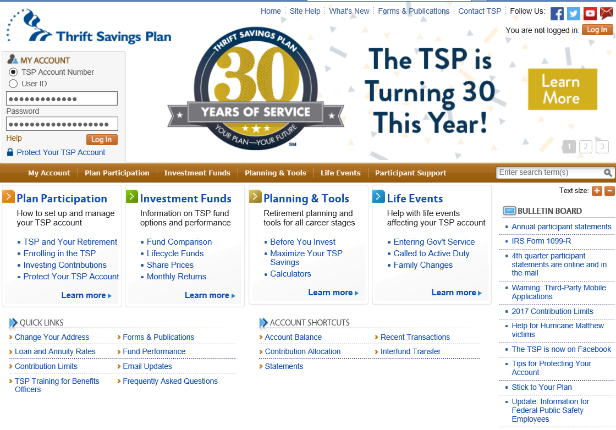
tsp.gov

Slide 31

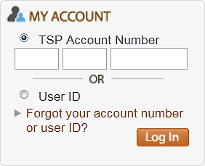
Access Your TSP Account
View account balance
View Annual & Quarterly Statements
Change contribution allocation
Request interfund transfers
Request loans and withdrawals
Create (or change a user ID)
Change or request a Web password

Slide 32
TSP Core Investment Funds
Bloomberg Barclays Capital U.S. Aggregate Bond Index
Dow Jones U.S. Completion Total Stock Market Index
S&P 500
Index
MSCI EAFE Index
G
FUND
F
FUND
C
FUND
S
FUND
I
FUND
Nonmarketable short-term U.S. Treasury security
Specially issued to the TSP
Index Investment Funds
Bonds
Stocks
High-quality fixed income securities with maturities of more than one year
Large – Medium companies
~82% of US stock market
Medium – Small companies
~the rest of US stock market
Large companies in developed countries
Domestic
TSP Fund Information on tsp.gov
Investment Option Review in Reading Room on frtib.gov/Reading Room
International

Slide 33
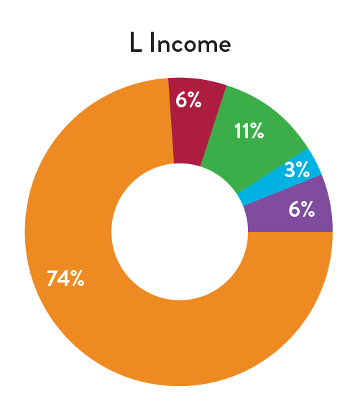
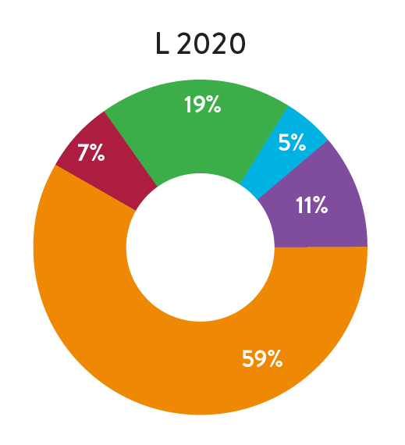
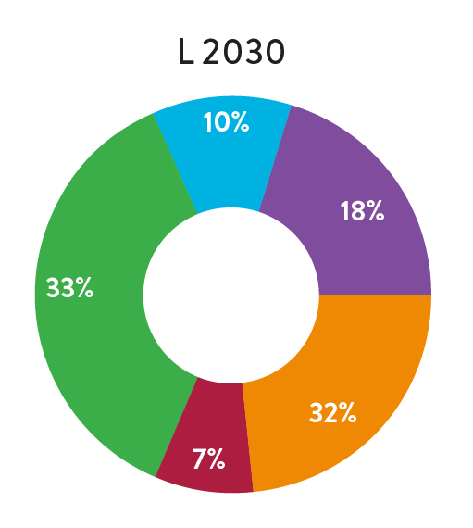
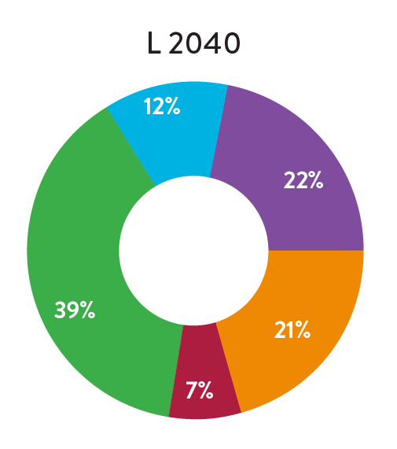
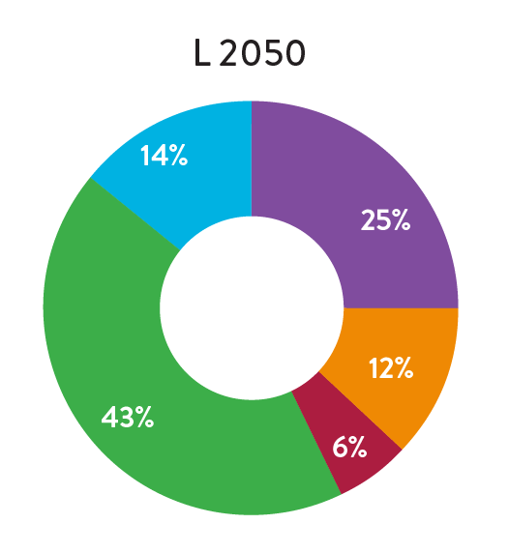
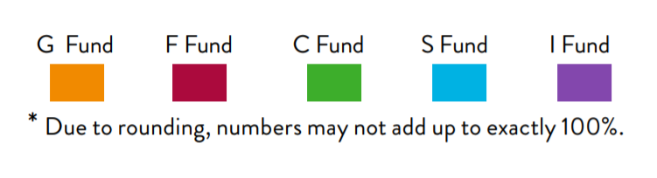

L Funds Investment Allocation
See: tsp.gov→ Investment Funds→ Fund Options→ Lifecycle Funds

Slide 34

Manage Your Own Mix
Determine your best asset balance
Rebalance on an annual basis
Reallocate risk with age
Reduce bond volatility by opting for the G fund over the F fund
Reduce stock volatility by opting for the C fund over S fund and S fund over the I fund

Slide 35
Let L Funds Manage Your Mix
Choose the fund that fits your investment objective and time horizon
Investment Objectives
Time Horizons
Fund | Growth | Preservation of assets
L 2050 | High | Very low
L 2040 | High | Low
L 2030 | Moderate/High | Low
L 2020 | Moderate | Moderate
L income | Low | High
If your time horizon is: | Choose
2045 and later | L 2050
2025 through 2044 | L 2040
2015 through 2034 | L 2030
Now through 2024 | L 2020
Now withdrawing | L Income

Slide 36
TSP Funds Performance Summary
11 Year Summary
G Fund
F Fund
C Fund
S Fund
I Fund
L 2040 Fund
The returns for the TSP funds represent net earnings after the deduction of administrative expenses, trading costs, and investment management fees
See the TSP Fund Information sheets or “Fund Performance” at tsp.gov.
34

Slide 37

Saving and Investing Techniques
Pay Yourself First
Automate Savings
Maximize Tax Advantaged Opportunities
Make Regular Monthly Investments

Slide 38

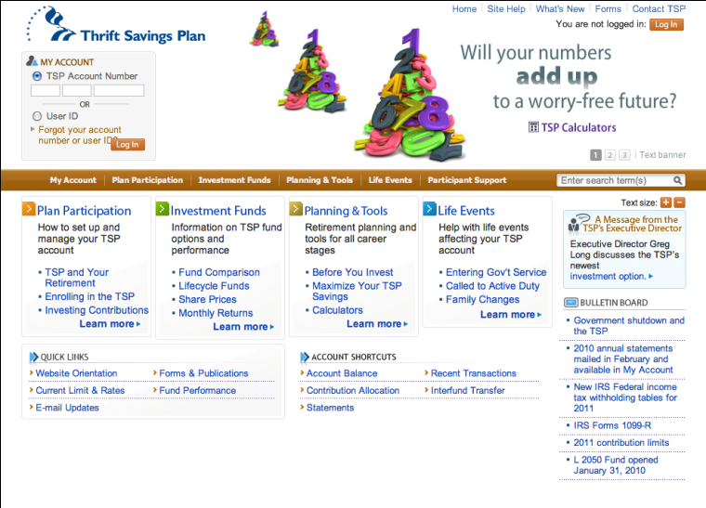
Resources
MCCS-PFM
CFS
www.tsp.gov
Bank or credit union
DFAS website

